Slide 1
CRC cfDNA (Agnostic) classification

Slide 2
Brief Procedure
Dimensionality reduction using metilene
Train a Random forest classifier

Slide 3
Train Test Separation
 | Number of CRC samples | Number of Healthy Samples
Train | 6 | 6
Test | 11 | 6
Tr
Tr
Tr
Tr
Tr
Tr

Slide 4
Classification Result
 | Number of CRC samples | Number of Healthy Samples
Train | 6 | 6
Test | 11 | 6
CRC
Healthy
?
SLD=0
✗
✗
?
Prediction Probability

Slide 5
PCA (Based on the RF Feature Importance)

Slide 6
PCA (Based on the RF Feature Importance)

Slide 7
Mapping to purified Samples
Purified Samples
CRC
Healthy
PBL
TIL
EPCAM

Slide 8
Mapping to purified Samples
Purified Samples
CRC
Healthy
PBL
TIL
EPCAM

Slide 9
Supp

Slide 10
PCA (After dimensionality reduction using metilene)

Slide 11
PCA (After dimensionality reduction using metilene)

Slide 12
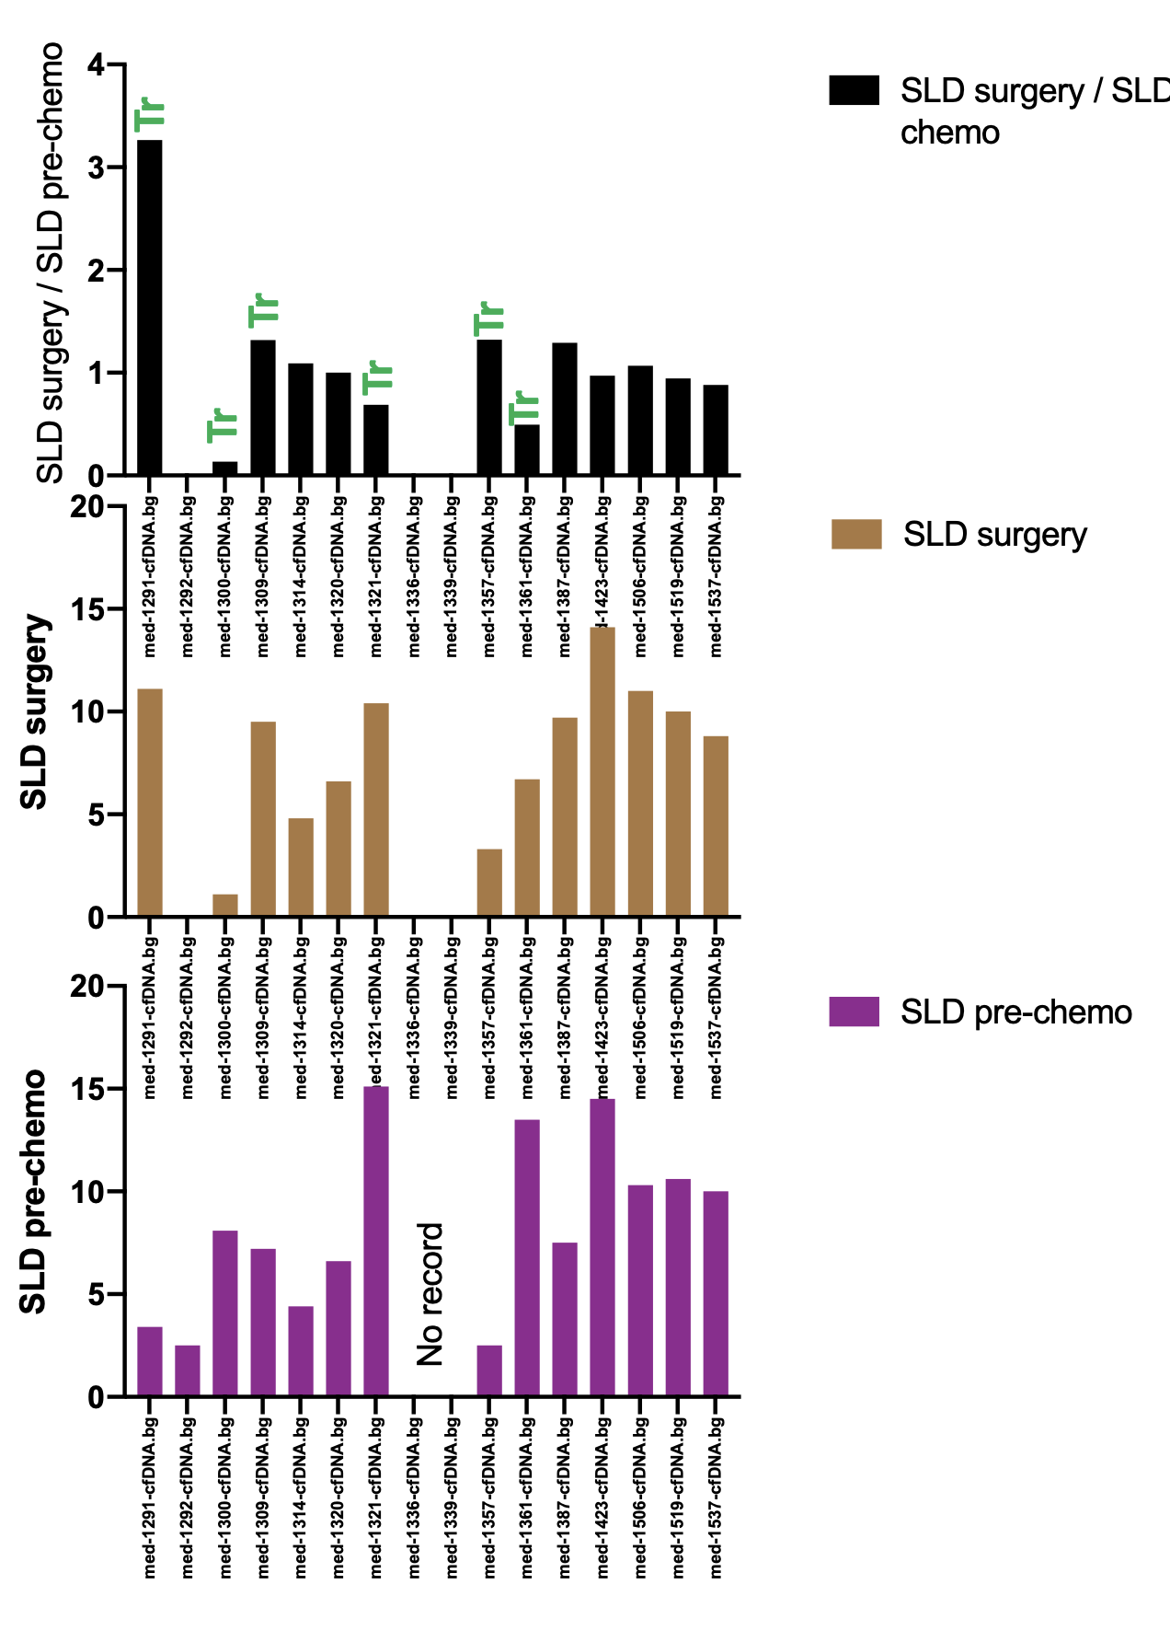
Classification Result
CRC
Healthy
?
SLD=0
✗
✗
?
Prediction Probability

Slide 13
Classification Result
CRC
Healthy
?
SLD=0
✗
✗
?
Prediction Probability

Slide 14
Classification Result
 | Number of CRC samples | Number of Healthy Samples
Train | 5 | 5
Test | 12 | 7
CRC
Healthy
?
SLD=0
✗
✗
?
Prediction Probability
Notes:
all_matrix_intesectedwith_mdiff5_sorted_merged_only_cfd.txt_cyberin_train.txt.pdf
But for meteline, using almost 8 samples each

Slide 15
Classification Result (training with those samples which were misclassified with Deconvolution)

Slide 16
Train Test Separation
 | Number of CRC samples | Number of Healthy Samples
Train | 6 | 6
Test | 11 | 6

Slide 17
In upcoming slides 1320 is included both in train and test
START

Slide 18
Classification Result (method 1)
 | Number of CRC samples | Number of Healthy Samples
Train | 6 | 6
Test | 11 | 6
CRC
Healthy
?
SLD=0
✗
✗
?
Prediction Probability

Slide 19
Classification Result (method 2)
 | Number of CRC samples | Number of Healthy Samples
Train | 6 | 6
Test | 11 | 6
CRC
Healthy
?
SLD=0
✗
✗
?
Prediction Probability

Slide 20
Difference Between method 1 and 2
Method1
Method2
Dimensionality reduction using metilene
Select CpG based on random forest feature importance
Train RF using “only” the selected CpG
Dimensionality reduction using metilene
Train RF

Slide 21
In above slides 1320 is included both in train and test
END

